Slide 1
CNA Gerontological Nursing Certification
AGNA Calgary Chapter
Study Group for RNs and LPNs

Slide 2
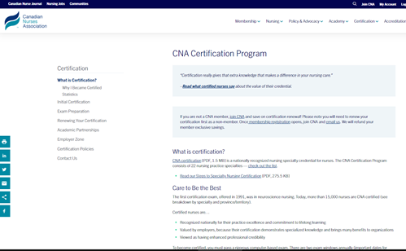
CNA Certification
What is Certification? - Canadian Nurses Association (cna-aiic.ca)
What is certification?
CNA certification is a nationally recognized nursing specialty credential for nurses (RNs, NPs, LPNs, & RPNs). The certification program consists of 22 nursing practice specialties – Gerontology is one of them.
GNC(C): Gerontological Nurse Certified (C)anada
GPNC(C): Gerontology Practical Nurse Certified (C)anada
Why certification?
Certification is a great way to demonstrate your continuing competence in your nursing specialty.
Today more than 13,000 nurses are CNA certified.
Be recognized for your commitment to lifelong learning, patient advocacy, and professional practice.
Certification has been valued increasingly by employers because their certification demonstrates specialized knowledge and brings many benefits to patients and organizations.
Viewed as having enhanced professional credibility.
CNA Specialties
https://www.cna-aiic.ca/en/certification/initial-certification/certification-nursing-practice-specialties

Slide 3
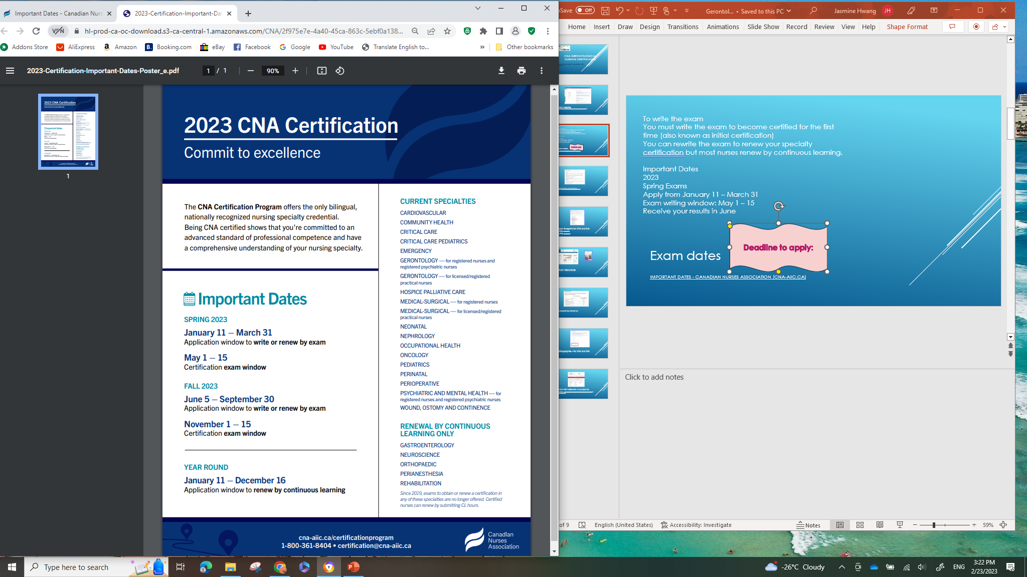
Exam dates
Important Dates - Canadian Nurses Association (cna-aiic.ca)
To write the exam
You must write the exam to become certified for the first time (also known as initial certification)
You can rewrite the exam to renew your specialty certification, but most nurses renew by continuous learning.
Important Dates
2023
Fall Exams
Apply from June 5 – September 30
Exam writing window: November 1 – 15
Receive your results in December
Deadline to apply:
Notes:
Don’t forget to do it early to receive employer approval before registering for the exam

Slide 4
New requirements
to make certification more accessible
Certification is made more accessible to nurses; this is to match changes in nursing curriculums and practice. The eligibility specialty experience hours required for application of the certification is reduced.
Two options
1,950 hours of experience in your nursing specialty within the last 5 years (formerly, 3,900 hours).
OR
1,000 hours of experience in your nursing specialty within the last 5 years plus 300 hours of formal education, which can be a specialty post-basic course or program at a college/university (as opposed to the former 2,925 hours of specialty experience plus education).
Application Process: https://www.cna-aiic.ca/en/certification/initial-certification/application-process

Slide 5
Financial Support
Check with your employers: You may want to look into the possibility of financial support from your employer. If your employer is funding your certification, be sure to submit the total amount of your online application.
Alberta Registered Nurses Educational Trust (ARNET): Continuing Education Grants provide partial funding for self-paid educational activities. You must be an RN or NP residing in Alberta. The exam must be completed before applying. Proof of completion (such as exam result and receipts) is required. https://arnet.ca/apply
Canadian Nurses Foundation (CNF): provides full reimbursements for CNA nursing specialty certification and renewal exams. Successful completion of the exam must be completed within the year of application.
https://cnf-fiic.ca/awards/
Contact AGNA (us!): reimburses for Calgary study group members (a total of $1,500)
  2 RNs for their initial certification ($300/person)
  2 RNs for their re-cert ($150/person)
  2 LPNs for their initial certification ($300/person)
CGNA/AGNA members save on the certification webinars, including a 20% voucher for writing a CNA certification exam or renewing your certification!
https://cgna.net/study-groups

Slide 6
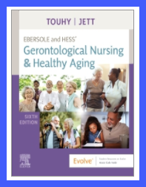
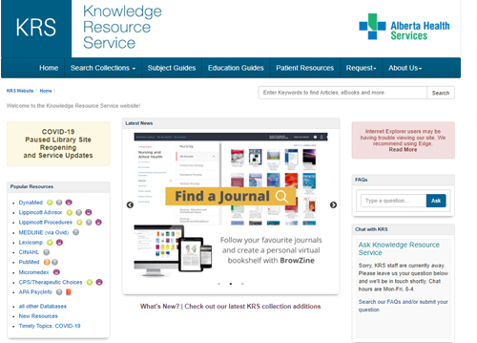
Exam Preparation
The certification exam is designed to evaluate the knowledge and skills expected of a nurse with experience in a given specialty. The exam will test you on national standards created by nursing experts.
CGNA Standards of Practice and Competencies (4th edition, 2020)
https://cgna.net/standards
Study Resources:
https://www.cna-aiic.ca/en/certification/exam-preparation
Exam competencies and blueprints
General competencies
Bibliographies
Specialty associations
Mentors
Study groups
Tips and tricks
Online practice questions
E-book library
AHS KRS (Knowledge Resource Service) – AHS employees
Notes:
Discuss where to find resources:
-colleagues, Employer, AHS employees can order textbooks from the Knowledge Resource Service (KRS)
Purchase textbooks from Amazon etc

Slide 7
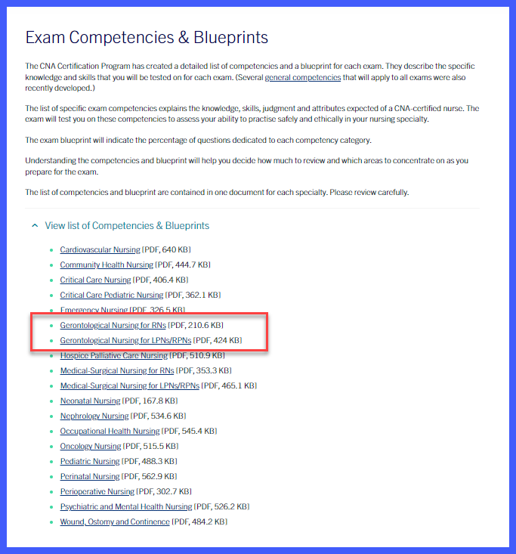
Exam Blueprints for LPNs and RNs
-RNs Blueprint for RNs
-LPNs Blueprint for LPNs https://www.cna-aiic.ca/en/certification/exam-preparation/exam-competencies-and-blueprints

Slide 8
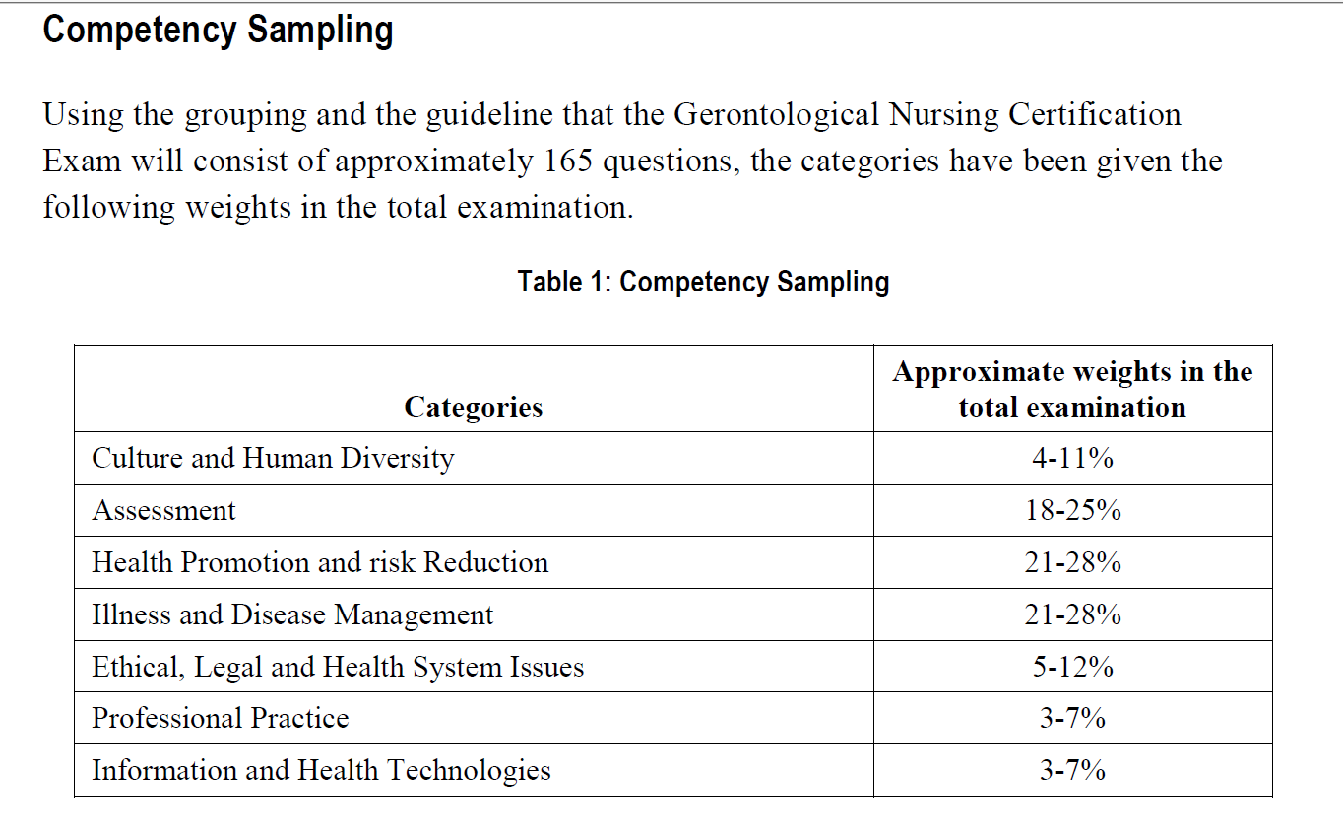
Competency sampling

Slide 9
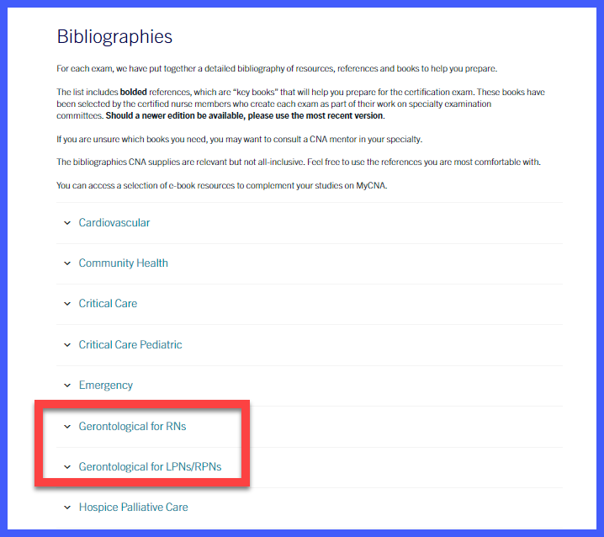
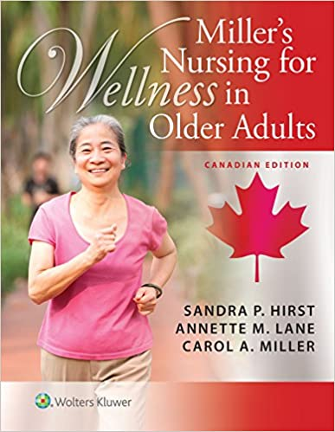
Bibliographies – for LPNs and RNs
Notes:
LPN curriculum are newer and competencies are different from RNs’

Slide 10
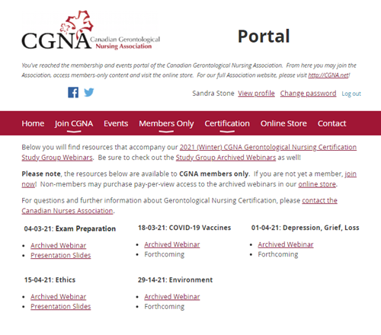
Archived webinars available on CGNA
Gerontological Nursing Certification Exam Resources Winter 2021 (wildapricot.org)

Slide 11
Study Group (Unavailable in Fall 2023)
1 – 1.5 hours per week for 8 weeks
Weekly topics
  Week 1: Study tips and tricks
  Week 2: Sexuality & Aging; pain management; sensory changes; cardiovascular disorders
  Week 3: Promoting healthy skin and feet; respiratory disorders; 3Ds
  Week 4: Age-related changes; nutrition; ageism; diabetes
  Week 5: Continence care; medication management; stroke
  Week 6: Ethics; bone, joint health; frailty & fall prevention
  Week 7: Rest, sleep & activity; chronic illnesses and health promotion; economic & legal issues
  Week 8: Social, psychological, spiritual, and cognitive aspects of aging; cancer; loss, death, & palliative care
  Each week, practice exam questions will be reviewed (approx. 10/week)

Slide 12
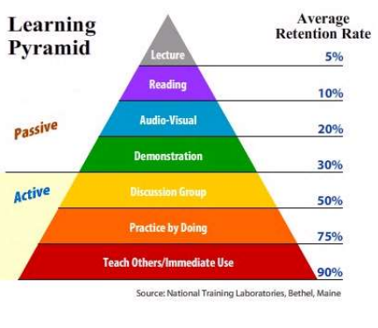
Study Group
Format: Teach & Learn experiential learning
Each person will pick and explore a topic and share important points and learning either via word document/PowerPoint Presentation/case study format (you can be creative). The rest of the group will bring questions regarding the topic.
Why do we like teach & learn?
  When engaged in active learning methods (teaching and learning, small group discussions, and sharing stories), our retention rate increases significantly
  Activities can also keep us more energized and make learning experiential! (Less boring!)
  We get to share our unique experiences as we work in various roles across different care settings and acquire indirect experiential learning.
Notes:
Minimum of 5 people and a maximum of 10 ppl must be registered for the study group
If we have less than 5 people, we will share study notes from a previous group. We will offer individual mentorship upon request.

Slide 13

Contact:
AGNA Study Group Facilitators
(Jasmine & Ilavarashi) agna.Calgary@gmail.com

